Slide 1
Design and Analysis of Algorithms
Lecture 9
Instructor: Mehak Riaz Khan
Email: Mehak.riaz@kiet.edu.pk

Slide 2
Sorting
Problem Definition:
Input is usually an n-element array.

Slide 3
Sorting-Structure of the data
Generally numbers are not isolated values. Rather the numbers are part of a record.
Each such record contains a key which is to be sorted. We are not really interested in the remaining data in the record, called the satellite data.
If the records are permuted, then the data also needs to be permuted; if data is large, then we often just permute pointers to the data.
We focus on the sorting problem; and assume the input consists of only numbers.

Slide 4
Heap Sort
Like merge sort, it’s running time is O(nlogn)
It sorts in place.
Heap sort introduces a design technique: heap
Heap can be visualized as a complete binary tree.

Slide 5
Trees
Why use Trees:
Linear access time of linear linked lists is prohibitive
  Does there exist any simple data structure for which the running time of most operations (search, insert, delete) is O(log N)?

Slide 6
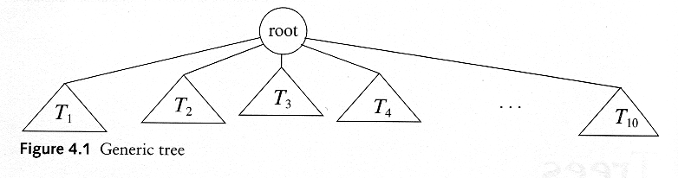
Trees
A tree is a collection of nodes
  The collection can be empty
  (recursive definition) If not empty, a tree consists of a distinguished node r (the root), and zero or more nonempty subtrees T₁, T₂, ...., T_{k}, each of whose roots are connected by a directed edge from r

Slide 7
Trees
Terminology
  Root ⇒ no predecessor
  Leaf ⇒ no successor
  Interior ⇒ non-leaf
  Height ⇒ distance from root to leaf
Root node
Interior nodes
Height
Leaf nodes

Slide 8
Some Terminologies
Path
Length
  number of edges on the path
Depth of a node
  length of the unique path from the root to that node
  The depth of a tree is equal to the depth of the deepest leaf
Height of a node
  length of the longest path from that node to a leaf
  all leaves are at height 0
  The height of a tree is equal to the height of the root
Ancestor and descendant
  Proper ancestor and proper descendant

Slide 9
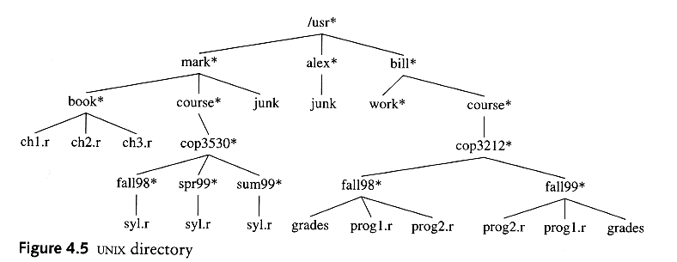
Example: UNIX Directory

Slide 10
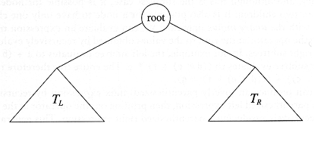
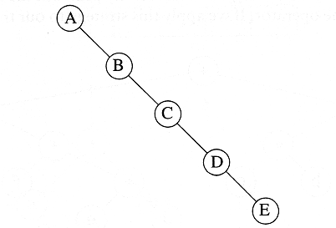
Binary Trees
A tree in which no node can have more than two children
The depth of an “average” binary tree is considerably smaller than N, even though in the worst case, the depth can be as large as N – 1.
Binary Tree

Slide 11
Types of Binary Trees
Perfect- A perfect binary tree is a type of binary tree in which every internal node has exactly two child nodes and all the leaf nodes are at the same level.
Full - A full Binary tree is a special type of binary tree in which every parent node/internal node has either two or no children.
Complete - A complete binary tree is a binary tree in which all the levels are completely filled except possibly the lowest one, which is filled from the left.
Balanced - A balanced binary tree, also referred to as a height-balanced binary tree, is defined as a binary tree in which the height of the left and right subtree of any node differ by not more than 1.
LST height – RST height <= 1

Slide 12

Complete or Not?

Slide 13
Balanced binary trees
Recall:
  The depth of a node is its distance from the root
  The depth of a tree is the depth of the deepest node
A binary tree of depth d is balanced if all the nodes at depths 0 through d-2 have two children
d-2
d-1
d
Balanced
Balanced
Not balanced

Slide 14
Why study Heapsort?
It is a well-known, traditional sorting algorithm you will be expected to know
Heapsort is always O(n log n)
  Quicksort is usually O(n log n) but in the worst case slows to O(n²)
  Quicksort is generally faster, but Heapsort is better in time-critical applications

Slide 15
What is a “heap”?
Definitions of heap:
  A large area of memory from which the programmer can allocate blocks as needed, and deallocate them (or allow them to be garbage collected) when no longer needed
  A balanced, left-justified binary tree in which no node has a value greater than the value in its parent
These two definitions have little in common
Heapsort uses the second definition

Slide 16
Outline
First, how to represent an array as a binary tree.
second, we will learn how to turn a binary tree into a heap
Next, we will learn how to turn a binary tree back into a heap after it has been changed in a certain way
Finally we will see how to use these ideas to sort an array

Slide 17
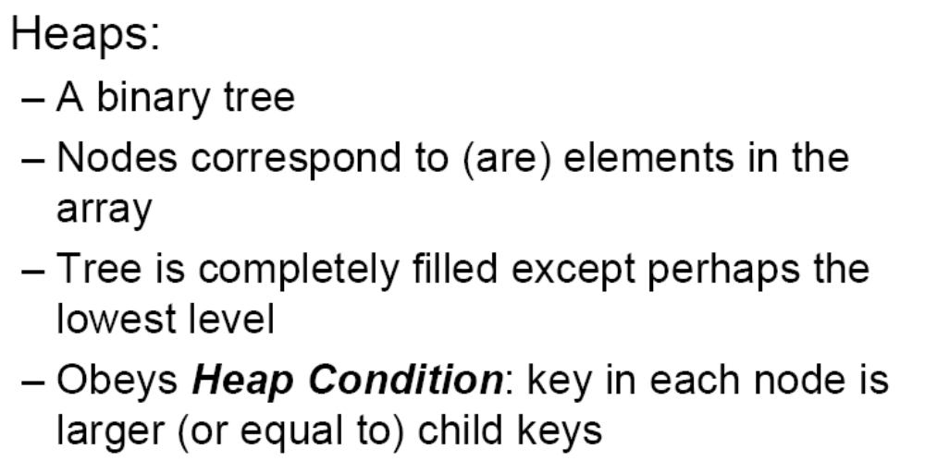
Heap Sort

Slide 18
The heap property
A node has the heap property (or heap condition) if the value in the node is as large as or larger than the values in its children
12
12
12
8
3
8
12
8
14
Blue node has heap property
Blue node has heap property
Blue node does not have heap property
All leaf nodes automatically have the heap property
A binary tree is a heap if all nodes in it have the heap property

Slide 19
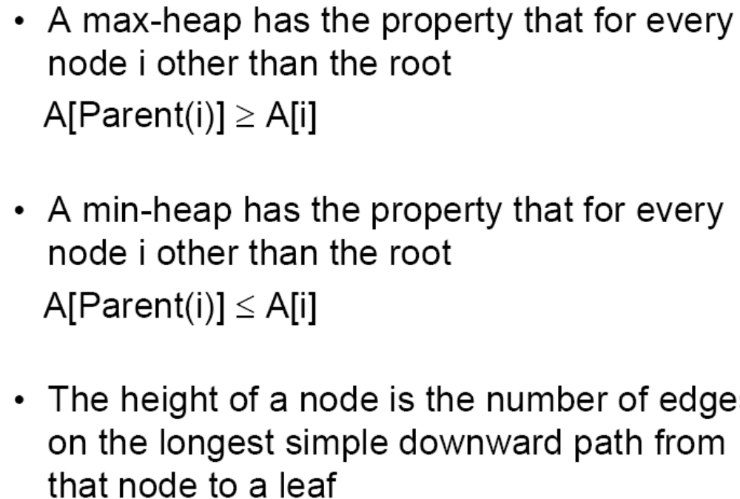
Types of Heaps

Slide 20
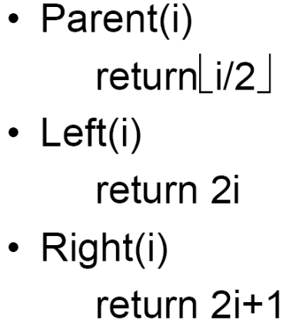
Mapping into an array
Get parent = index/2 = answer(floor function)
25
22
17
19
22
14
15
18
14
21
3
9
11
1 2 3 4 5 6 7 8 9 10 11 12 13
25
22
17
19
22
14
15
18
14
21
3
9
11
Notice:
  The left child of index i is at index 2*i
  The right child of index i is at index 2*i+1
  Example: the children of node 3 (19) are 7 (18) and 8 (14)

Slide 21
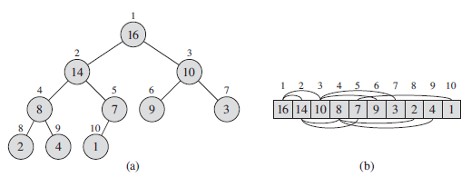
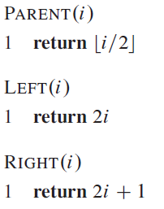

Slide 22
Exercise
Is the array with values {23; 17; 14; 6; 13; 10; 1; 5; 7; 12} a max-heap?
Is this array with values {1,3,5,4,6,13,10,9,8, 15,17} a max-heap?

Slide 23
Construction
Three main procedures:
  HEAPIFY: to maintain the heap property
  BUILD_HEAP: produces a heap from an unsorted input array
  HEAPSORT: sorts an array in place
EXTRACT-MAX and INSERT procedures, allow the heap data structure to be used as a priority queue

Slide 24
HEAPIFY
Given a node that does not have the heap property, you can give it the heap property by exchanging its value with the value of the larger child
12
14
8
14
8
12
Blue node does not have heap property
Blue node has heap property
Notice that the child may have lost the heap property

Slide 25
A sample heap
Here’s a sample binary tree after it has been heapified
25
22
17
19
22
14
15
18
14
21
3
9
11
Notice that heapified does not mean sorted
Heapifying does not change the shape of the binary tree; this binary tree is balanced and left-justified because it started out that way

Slide 26
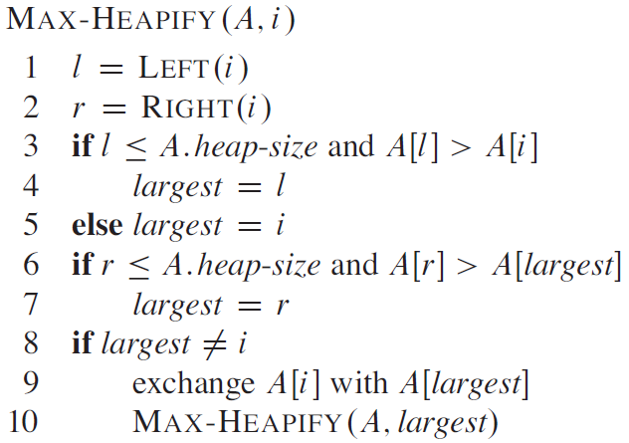
HEAPIFY-pseudo code
At each step, the largest element is determined and stored in largest variable
If A[i] is largest, the procedure terminates
Otherwise, the A[i] is swapped with one of it’s children. Which might violate the heap property.
Need to call HEAPIFY recursively

Slide 27
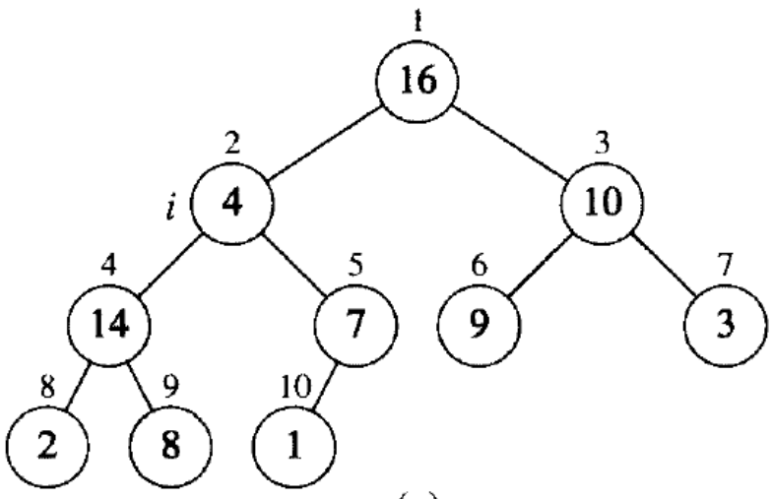
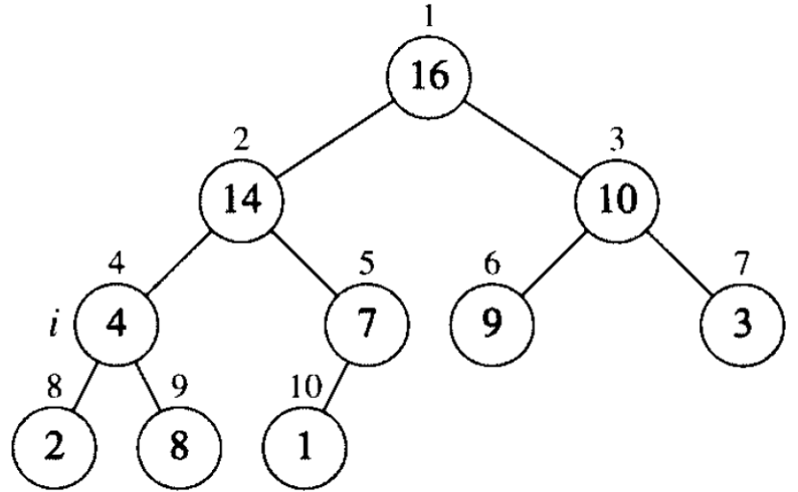
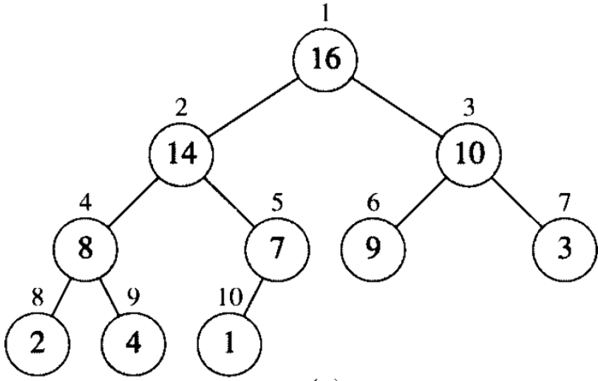
HEAPIFY- example
HEAPIFY(A,2)

Slide 28
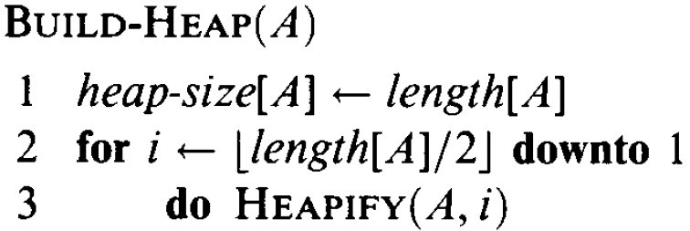
BUILD-HEAP
We run the HEAPIFY in a bottom-up manner to convert an array in to a heap.
Each call to HEAPIFY costs O(logn) and there are O(n) such calls. The running time is thus at most O(n log n )

Slide 29
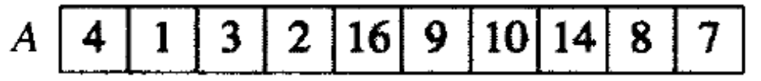
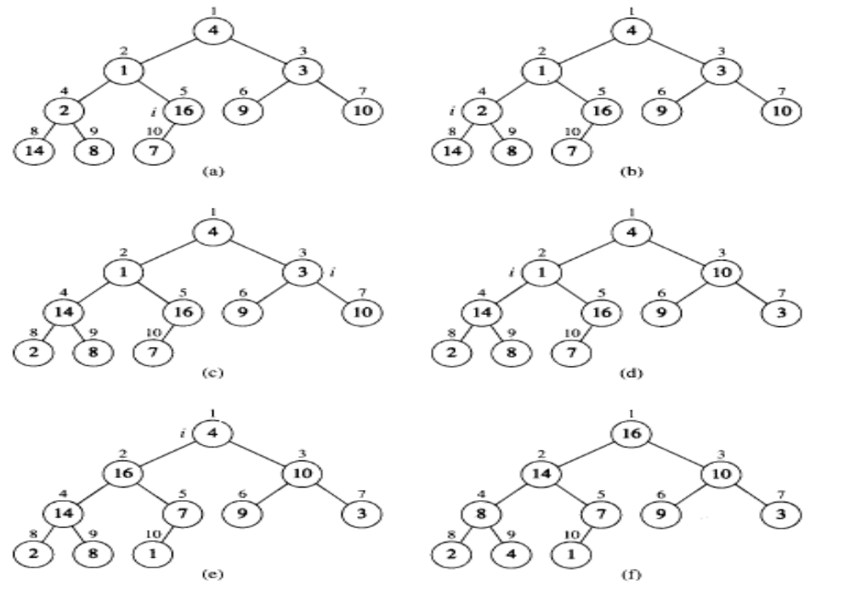
Example:

Slide 30
Removing the root
Notice that the largest number is now in the root
Suppose we discard the root:
11
22
17
19
22
14
15
18
14
21
3
9
11
How can we fix the binary tree so it is once again balanced and left-justified?
Solution: remove the rightmost leaf at the deepest level and use it for the new root

Slide 31
The reHeap method I
Our tree is balanced and left-justified, but no longer a heap
However, only the root lacks the heap property
11
22
17
19
22
14
15
18
14
21
3
9
We can HEAPIFY the root
After doing this, one and only one of its children may have lost the heap property

Slide 32
The reHeap method II
Now the left child of the root (still the number 11) lacks the heap property
22
11
17
19
22
14
15
18
14
21
3
9
We can HEAPIFY this node
After doing this, one and only one of its children may have lost the heap property

Slide 33
The reHeap method III
Now the right child of the left child of the root (still the number 11) lacks the heap property:
22
22
17
19
11
14
15
18
14
21
3
9
We can HEAPIFY this node
After doing this, one and only one of its children may have lost the heap property —but it doesn’t, because it’s a leaf

Slide 34
The reHeap method IV
Our tree is once again a heap, because every node in it has the heap property
22
22
17
19
21
14
15
18
14
11
3
9
Once again, the largest (or a largest) value is in the root
We can repeat this process until the tree becomes empty
This produces a sequence of values in order largest to smallest

Slide 35
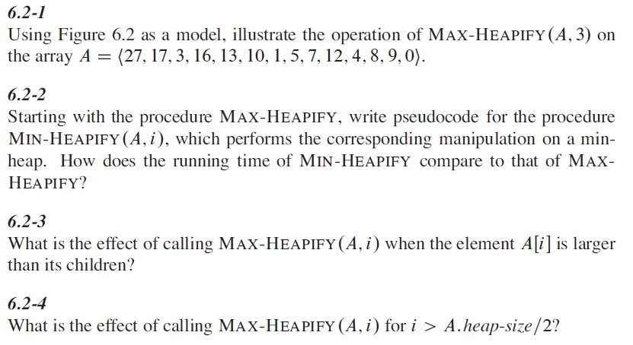

Slide 36
Sorting
What do heaps have to do with sorting an array?
Here’s the neat part:
  Because the binary tree is balanced and left justified, it can be represented as an array
  All our operations on binary trees can be represented as operations on arrays
  To sort:
    heapify the array;
    while the array isn’t empty {
    remove and replace the root;
    reheap the new root node;
    }

Slide 37
Removing and replacing the root
The “root” is the first element in the array
The “rightmost node at the deepest level” is the last element
Swap them...
1 2 3 4 5 6 7 8 9 10 11 12 13
25
22
17
19
22
14
15
18
14
21
3
9
11
1 2 3 4 5 6 7 8 9 10 11 12 13
11
22
17
19
22
14
15
18
14
21
3
9
25
...And pretend that the last element in the array no longer exists—that is, the “last index” is 12 (9)

Slide 38
Reheap and repeat
Reheap the root node (index 0, containing 11)...
1 2 3 4 5 6 7 8 9 10 11 12 13
11
22
17
19
22
14
15
18
14
21
3
9
25
1 2 3 4 5 6 7 8 9 10 11 12 13
22
22
17
19
21
14
15
18
14
11
3
9
25
1 2 3 4 5 6 7 8 9 10 11 12 13
9
22
17
19
22
14
15
18
14
21
3
22
25
...And again, remove and replace the root node
Remember, though, that the “last” array index is changed
Repeat until the last becomes first, and the array is sorted!

Slide 39
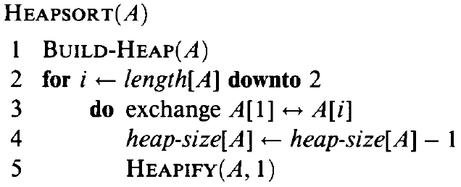
Algorithm

Slide 40
Algorithm & Analysis
Here’s the algorithm:
HEAPIFY takes O(log n) time
BUILD-HEAP takes O(nlogn)
Heap Sort is thus O(nlogn)

Slide 41
Illustrate the operation of HEAPSORT on the array A = {5; 13; 2; 25; 7; 17; 20; 8; 4}

